Slide 1
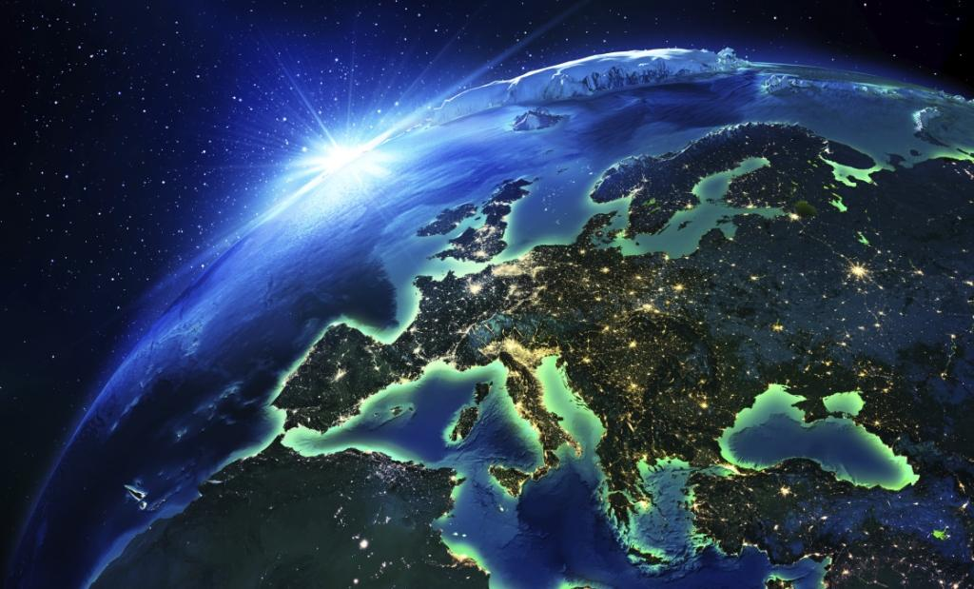
You can’t get all the money,
You can’t owe the whole world,
But you can have the best, it’s really funny,
You need luck and good taste. If not – it’s your fault
-Arti
There are some things that are
not to earn ON them, but to earn FOR them.
Worth to LIVE FOR THEM…

Slide 2
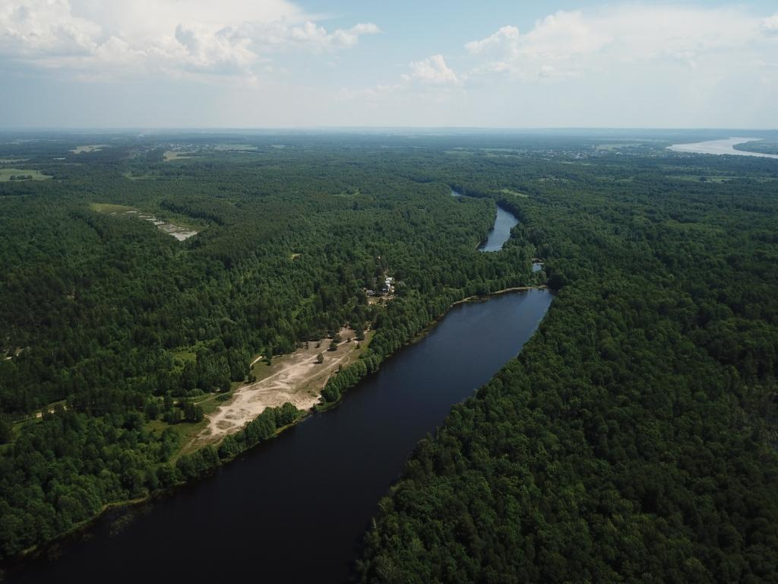

Slide 3
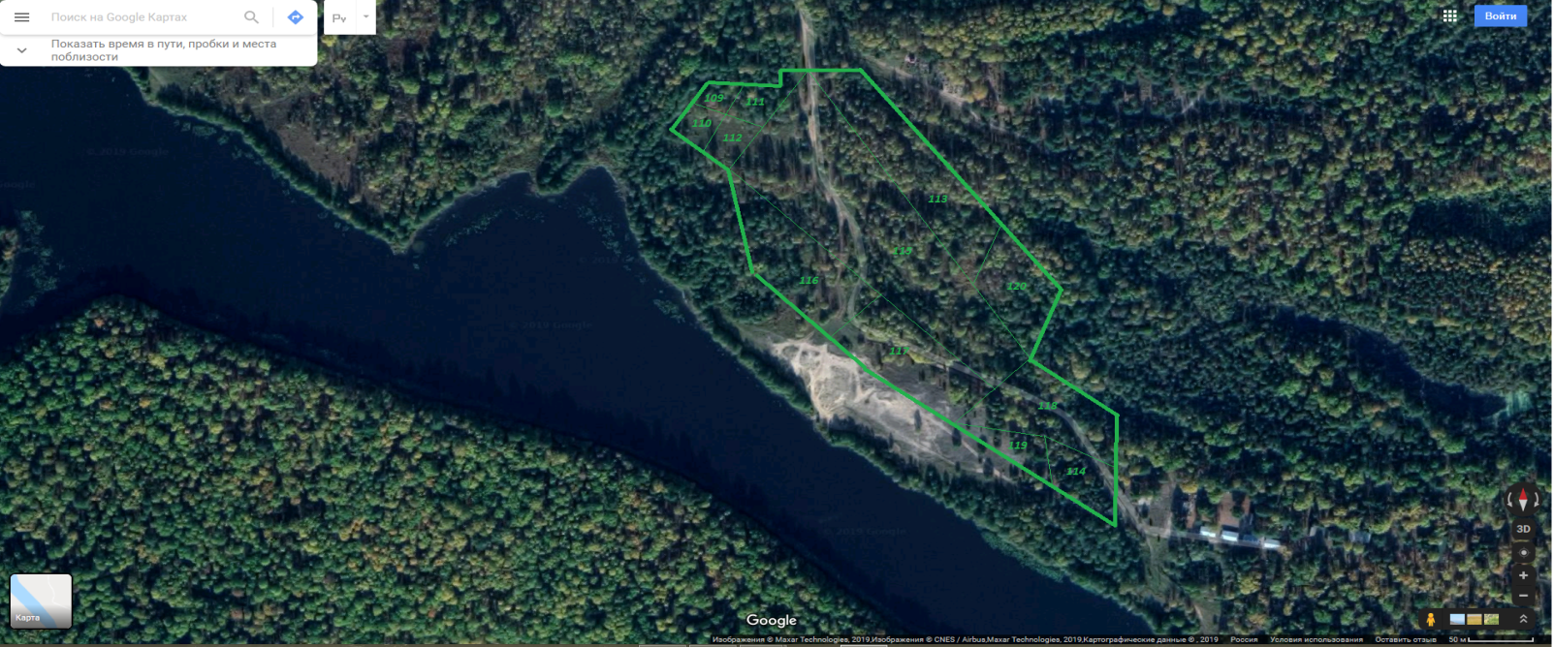
● Lands in a size of 4.4 hectares (divided into 9 pieces), called “the Land” hereinafter.
Purpose of use – recreational area (not for private houses, it can be resort, hotel or etc),
● This is THE ONLY private land here around on the lakes near the confluence of the biggest rivers of European Russia. There are no other constructions breaking the scene and harmony. There is just one neighbor – tour base, holiday camping “Chaika”. But it’s a friend – charity eco-projects, cleaning of the forests and lakes, electricity and security spot,
● Lying on the edge of the forests and lakes territories that are forbidden for sale by law, this exclusive Land owner can be sure in its secluded location for his guests and him for generations.

Slide 4
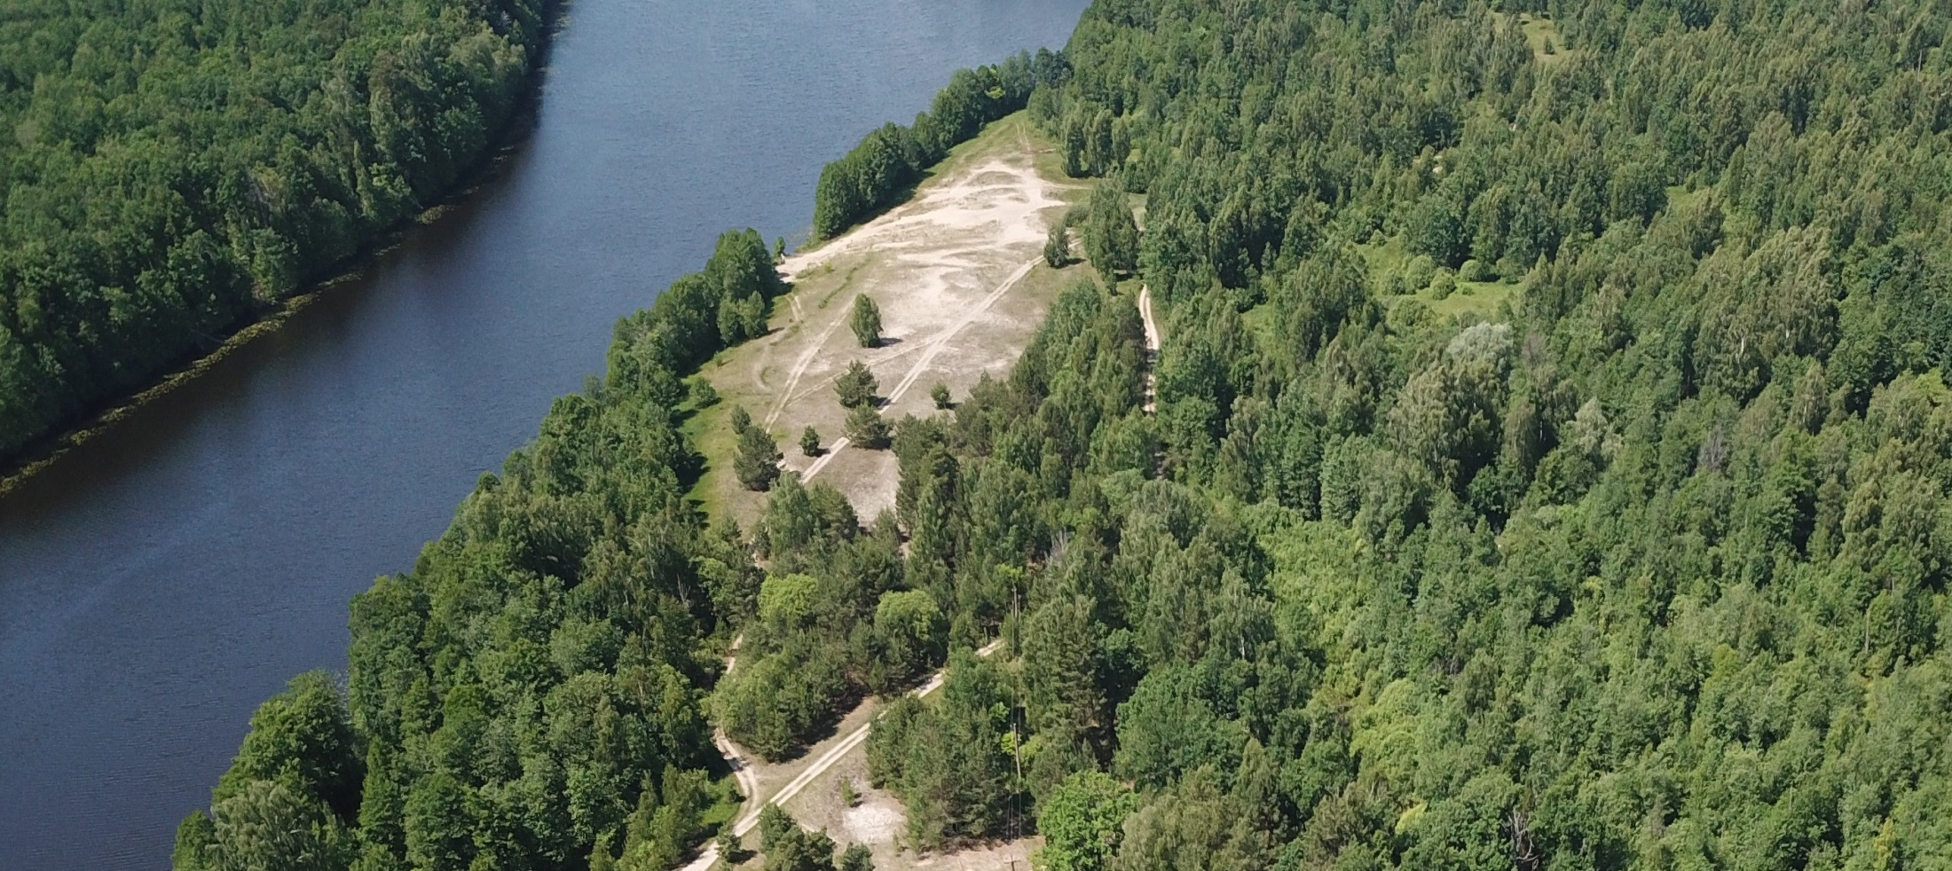
● Nearly the whole Land offered on sale is in this picture. Located 50 meters from the lake (it is obligatory condition by the Russian law) it spans for 350 meters from the road fork at the bottom of the photo along the lake side. The camping territory starts just in 50 meters.
● There are some local people on this beach area of Borschacheye lake during hot summer days, but nearly no people at all in the lakes located nearby.
● The road you can see in the picture in fact finishes at the camping entrance. Though it’s going aside the tour base towards the lakes and the Klyazma and Oka rivers, nowadays only special cars or real off-roaders can be sure about their further trip.

Slide 5
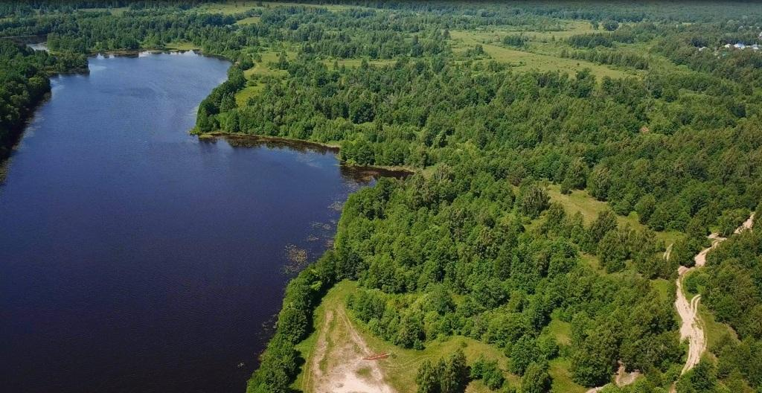
● The lakeside edge of the Land can be seen near the lagoon on the right. 50 meters further there is a natural border so the real expressions from the ownerships’ size are much more impressive.
● The nearest houses of the Ilina-Gora village can be seen in the upper right corner. It’s about 1.5 kilometers from the edge of the Land. The picturesque lands on the way from the village can be bought or rented later, if needed.

Slide 6
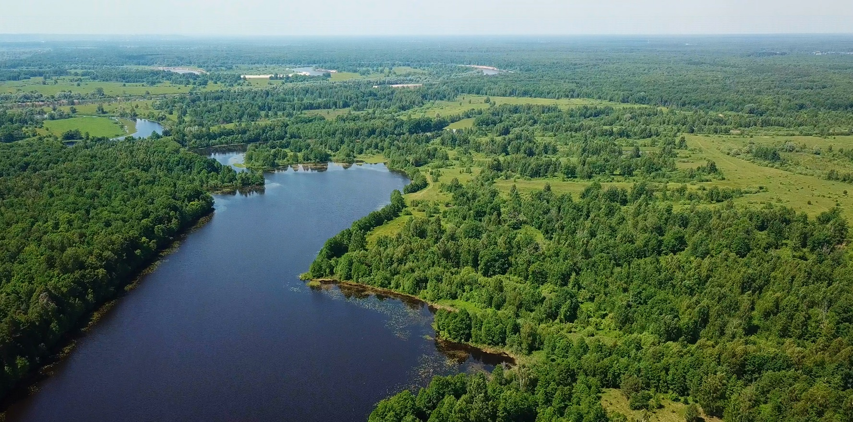
● It’s the view to the West, to the Sunset. This is the end side of Borschacheye lake. There is a mirror-like surface of Zavod lake and the Klyazma river ellipse a bit further.
● This is just one direction out of other three ones that can be used for walking, horse, bike, jeep or water safaris. Hundreds of hectares with nearly no people. And it’s not far.
Folk and theme routes, fishing, hunting, mushrooms, berries. Animal feeding stations. Festivals, air-baloon and motor parasailing fields, TV or cinema production venues.

Slide 7
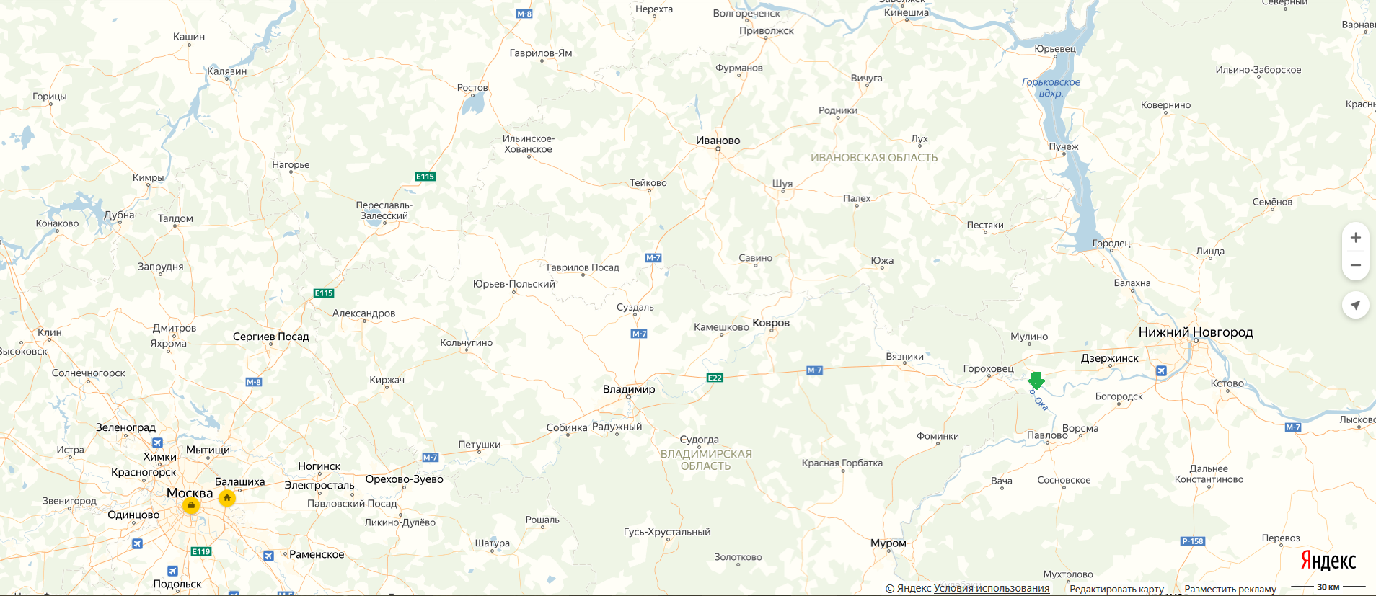
Location:
● Moscow – 350 km, Vladimir – 170 km, Nizhniy Novgorod – 60 km, Dzerzhinsk – 35 km;
● М7 “Volga” highway Moscow-N. Novgorod – 8 km;
● N. Novgorod/ airport – 55 km, railway stations: Ilino – 4 km, Dzerzhinsk – 40 km,
Gorokhovets – 15 км, Vladimir – 170 km;
Duration time from Moscow:
● Fast trains Lastochka|Sapsan – from 3.5h to «Dzerzhinsk» (from 1000 rubles) + 40 min. by taxi (~900 rubles). Night trains from 5h to “Ilino” station + 15 min. by taxi;
● Car/ taxi or bus – by М7 highway ~4.5h (taxi cost is about 7000 rubles);
● Air – ~1h to N. Novgorod/ Strigino airport (from 3000 rubles) + ~1h by taxi (~2000 rubles)

Slide 8
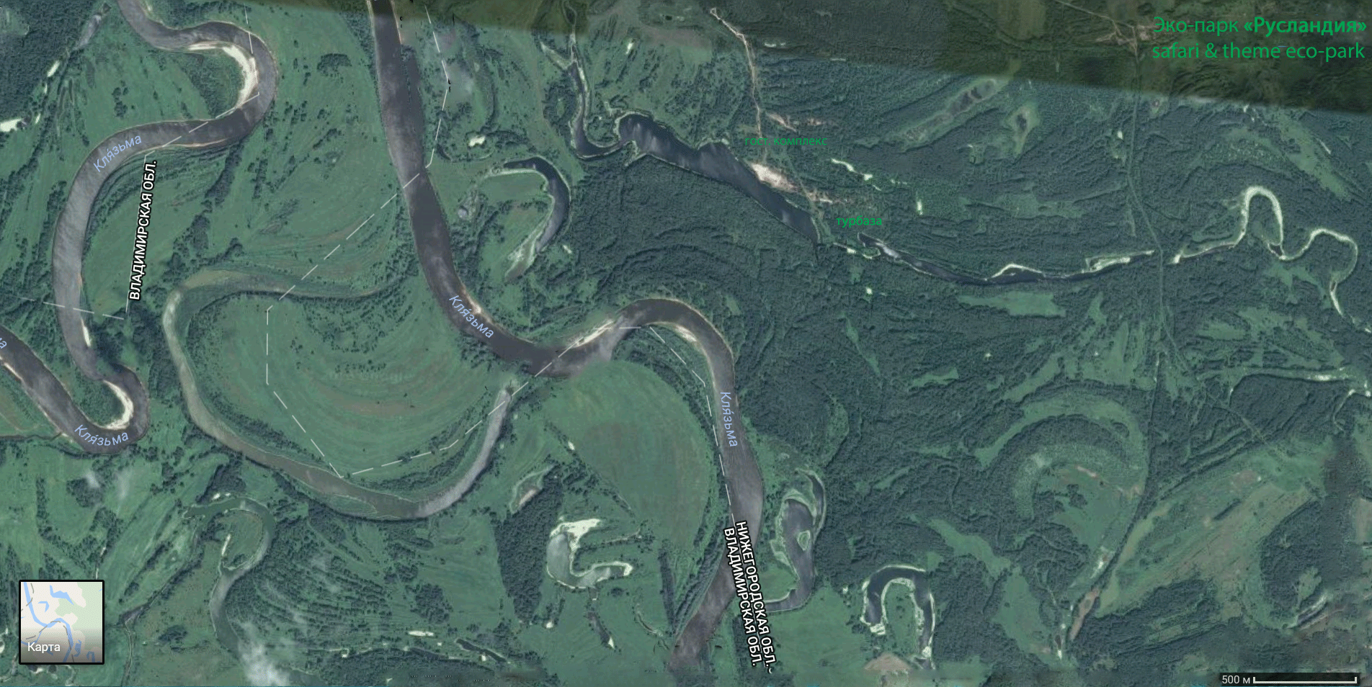
● Private choice is a matter of taste… And someone really would prefer deserts to mountains, lakes to oceans, oceans to seas. The best landscapes of Central Russia can be found on rivers, lakes, water preservations/handmade seas, so we don’t compare to the Alps or the Maldives,
● Probably, local lakes cannot be suitable for yacht owners but they are definitely more cozy, predictable, quite and safe. All local lakes are of different beauty, covered by beautiful forests and very secluded. And there are rivers here anyway! Even 2, though in 15-45 minutes walking time.

Slide 9
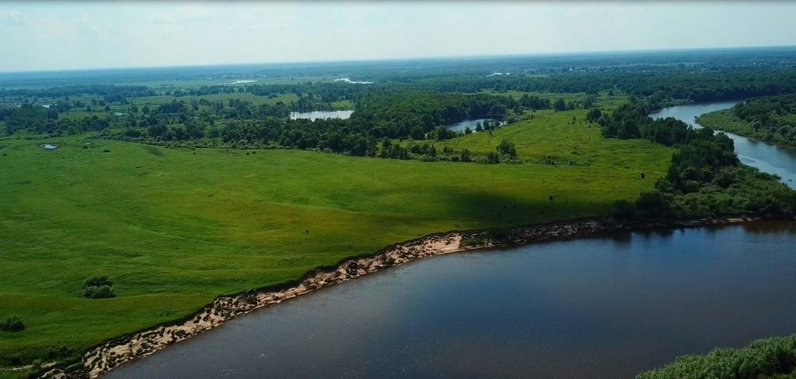
● It is a view of the opposite bank of the Klyazma river with future golf courses near Staritsa bay. It is already Vladimir region. Walking distance from the Land – 45 minutes plus boat ferry. It is about 5 km away from the point of the Klyazma and Oka confluence. The nearest village is in about 3 km, famous lands of the great Russian cinema producer Nikita Mikhalkov are located in about 10 km from here.
● Meanwhile, these lands are very similar to Eco-park lands. Though these lands are closer to Moscow on the map they are actually much worse to get there. Moreover there are no infrastructure possibilities there.

Slide 10
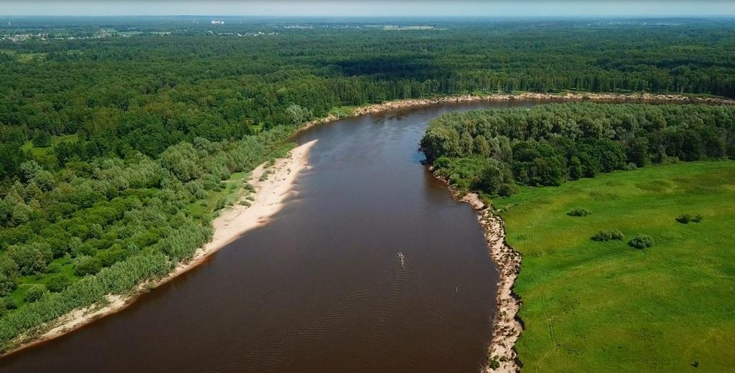
● The view of the Land and Eco-park territory from the opposite side of the Klyazma river, from Vladimir region side. Walking time to get here from the Land is 45 minutes. The nearest village and train station can be seen at the far end of this photo,
● The Klyazma river’ delta is an environment special preservation zone and the natural boarder.
● Natural reservation territories alongside the Oka river to the Land area – State natural heritage (about 3,500 hectares), so the protection of the forests between the Land and the Klyazma (1.5 km) and the Oka rivers (3 km) is guaranteed.

Slide 11
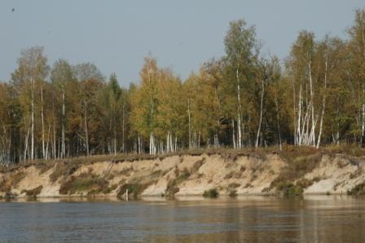
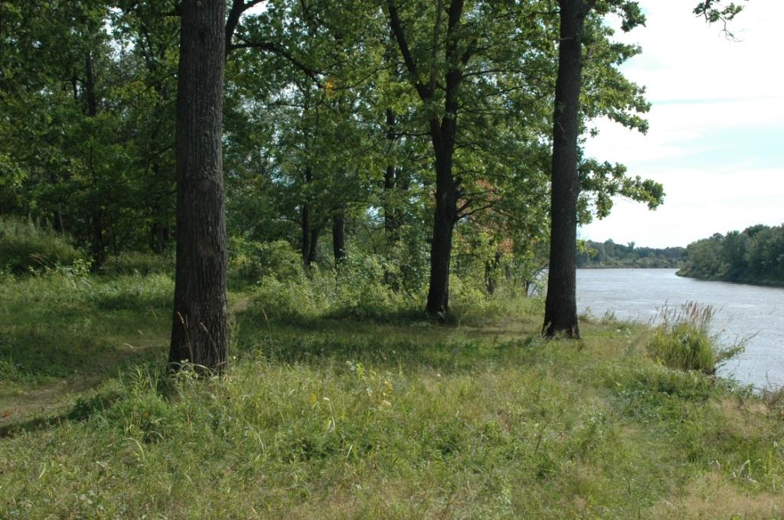
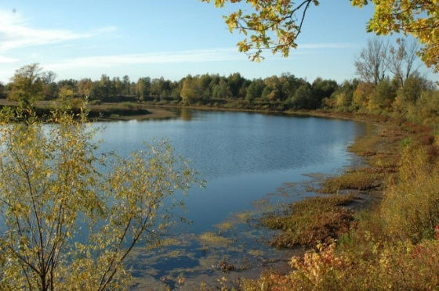
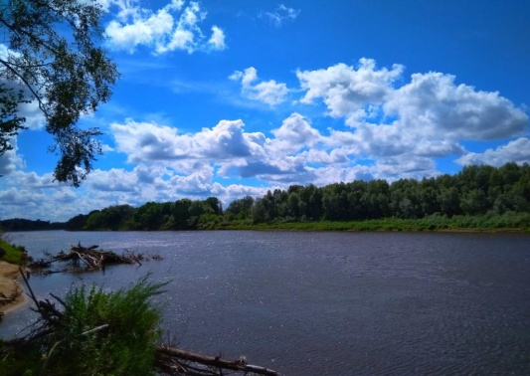
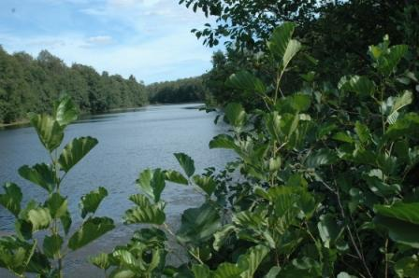
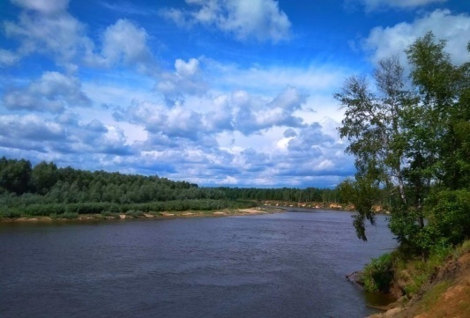
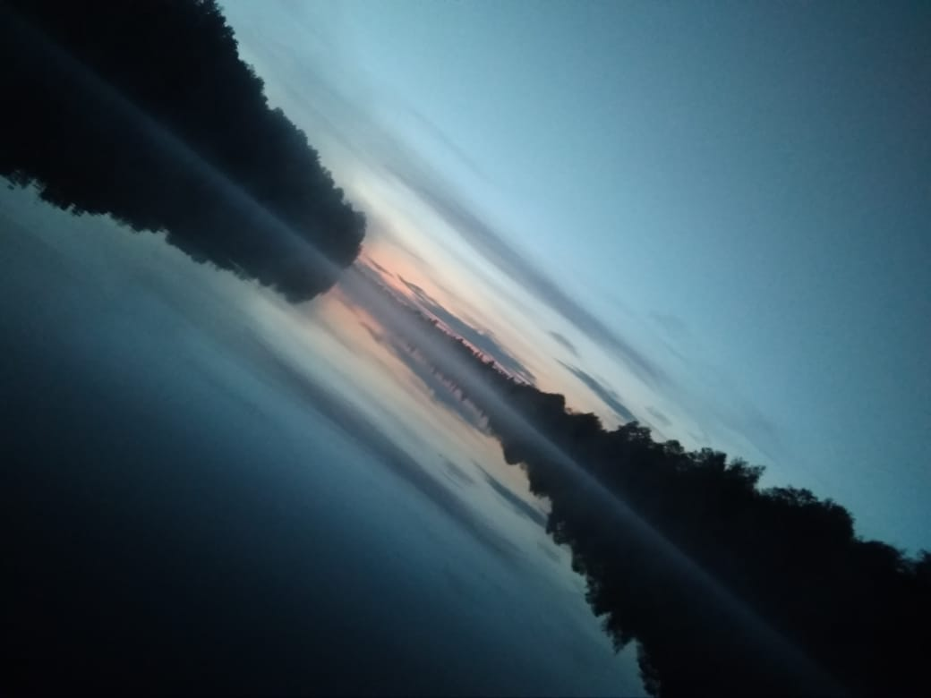
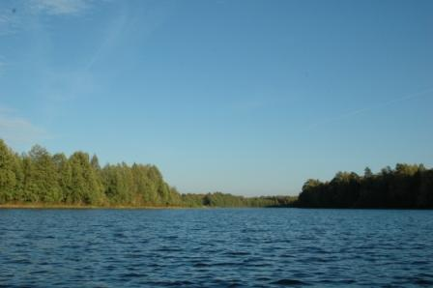
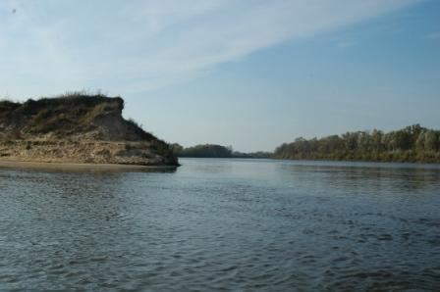
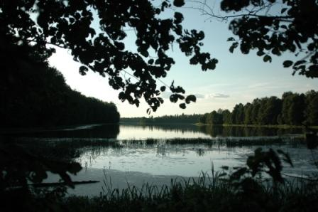
● Borschacheye 50m, Dolgoe 150м, Zavod 1km, Krutoe & Tikhoe 1.5km, Klyazma 1.5km and Oka 4 km

Slide 12
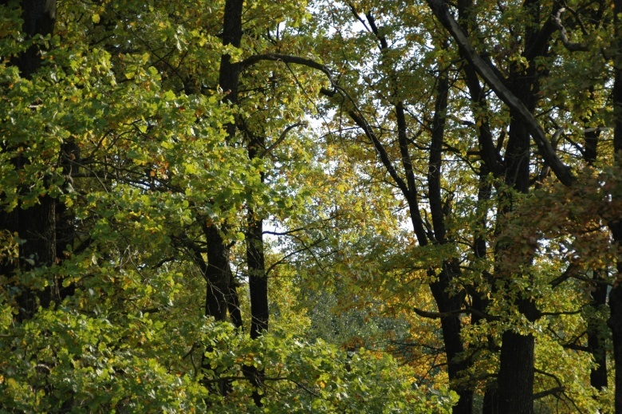
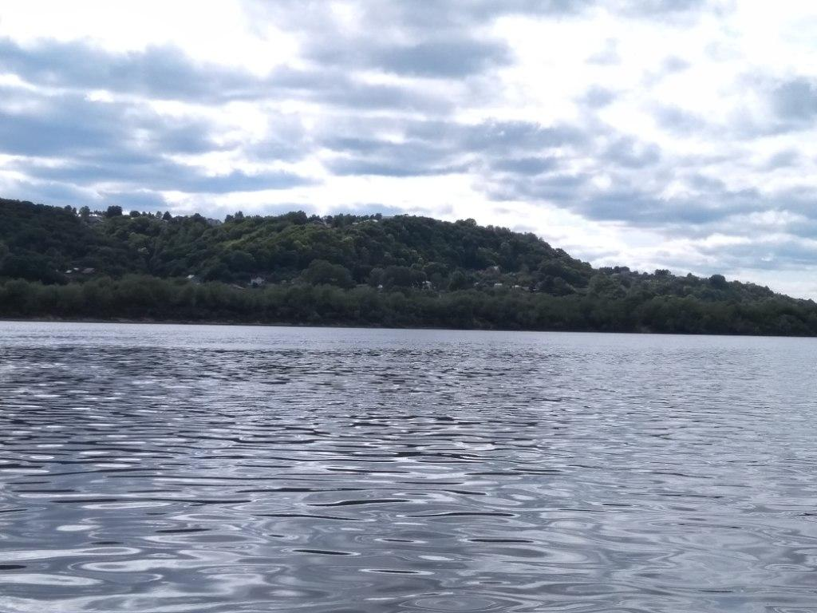
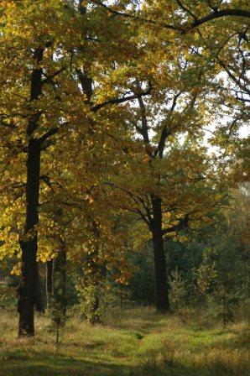
● The local ecological situation is one of the best in the region due to the wind rose and location of the Land area 50 km upstream the Oka river from the plants. This is confirmed by regular air and water control. So, hundreds of sq kilometers around just a green zone, lakes and magnetism of the rivers’ confluence: the picturesque Suvorosh and the Luh join to the Klyazma and the Klyazma flows to the Oka, making it more full-flowing here than the Volga.

Slide 13
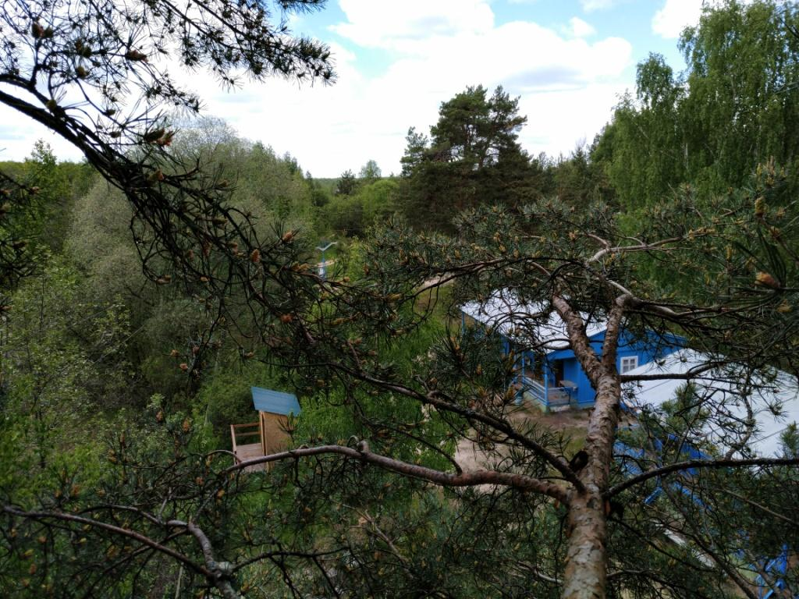
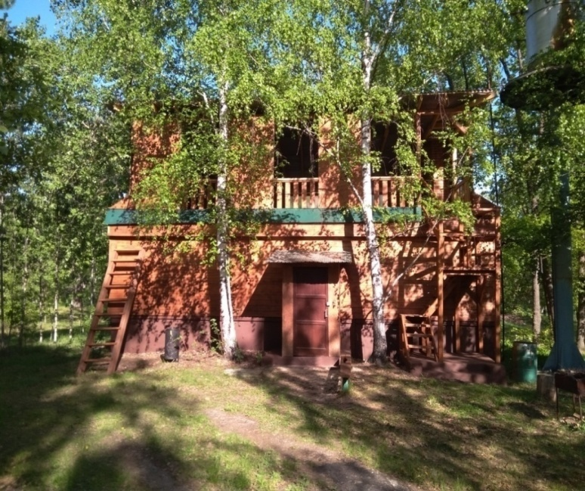
● Camping “Chaika” (means “Seagull”) adjoining the Land – is an integral part of the Eco-park project. For many years “Chaika” was a property of the government plant and from 2015 it belongs to a charity foundation. After a long conservation and later full reconstruction it was open again in the year of its 50th Anniversary. All programs of the camping are educational, sport, thematic and ecological sessions. This is the base for adventure travel and nature protection.
● “Chaika” is a seasonal camping. 8 summer cottages, an open-air cafeteria, kitchen, a medical centre, a couple of terraces, a warehouse, a couple of pavilions, a shower/sauna spot, a few WC cabins. In any way of the Land development this camping will be definitely helpful for the Land owners: mutual work at a landscape design, in forming the road and new beaches, in operating theme and folk paths, sanitary, electricity and security jobs in the Land area, big events administration. When available the camping can extend the range of the Land services by providing budget rooms for some part of a group, for example.

Slide 14
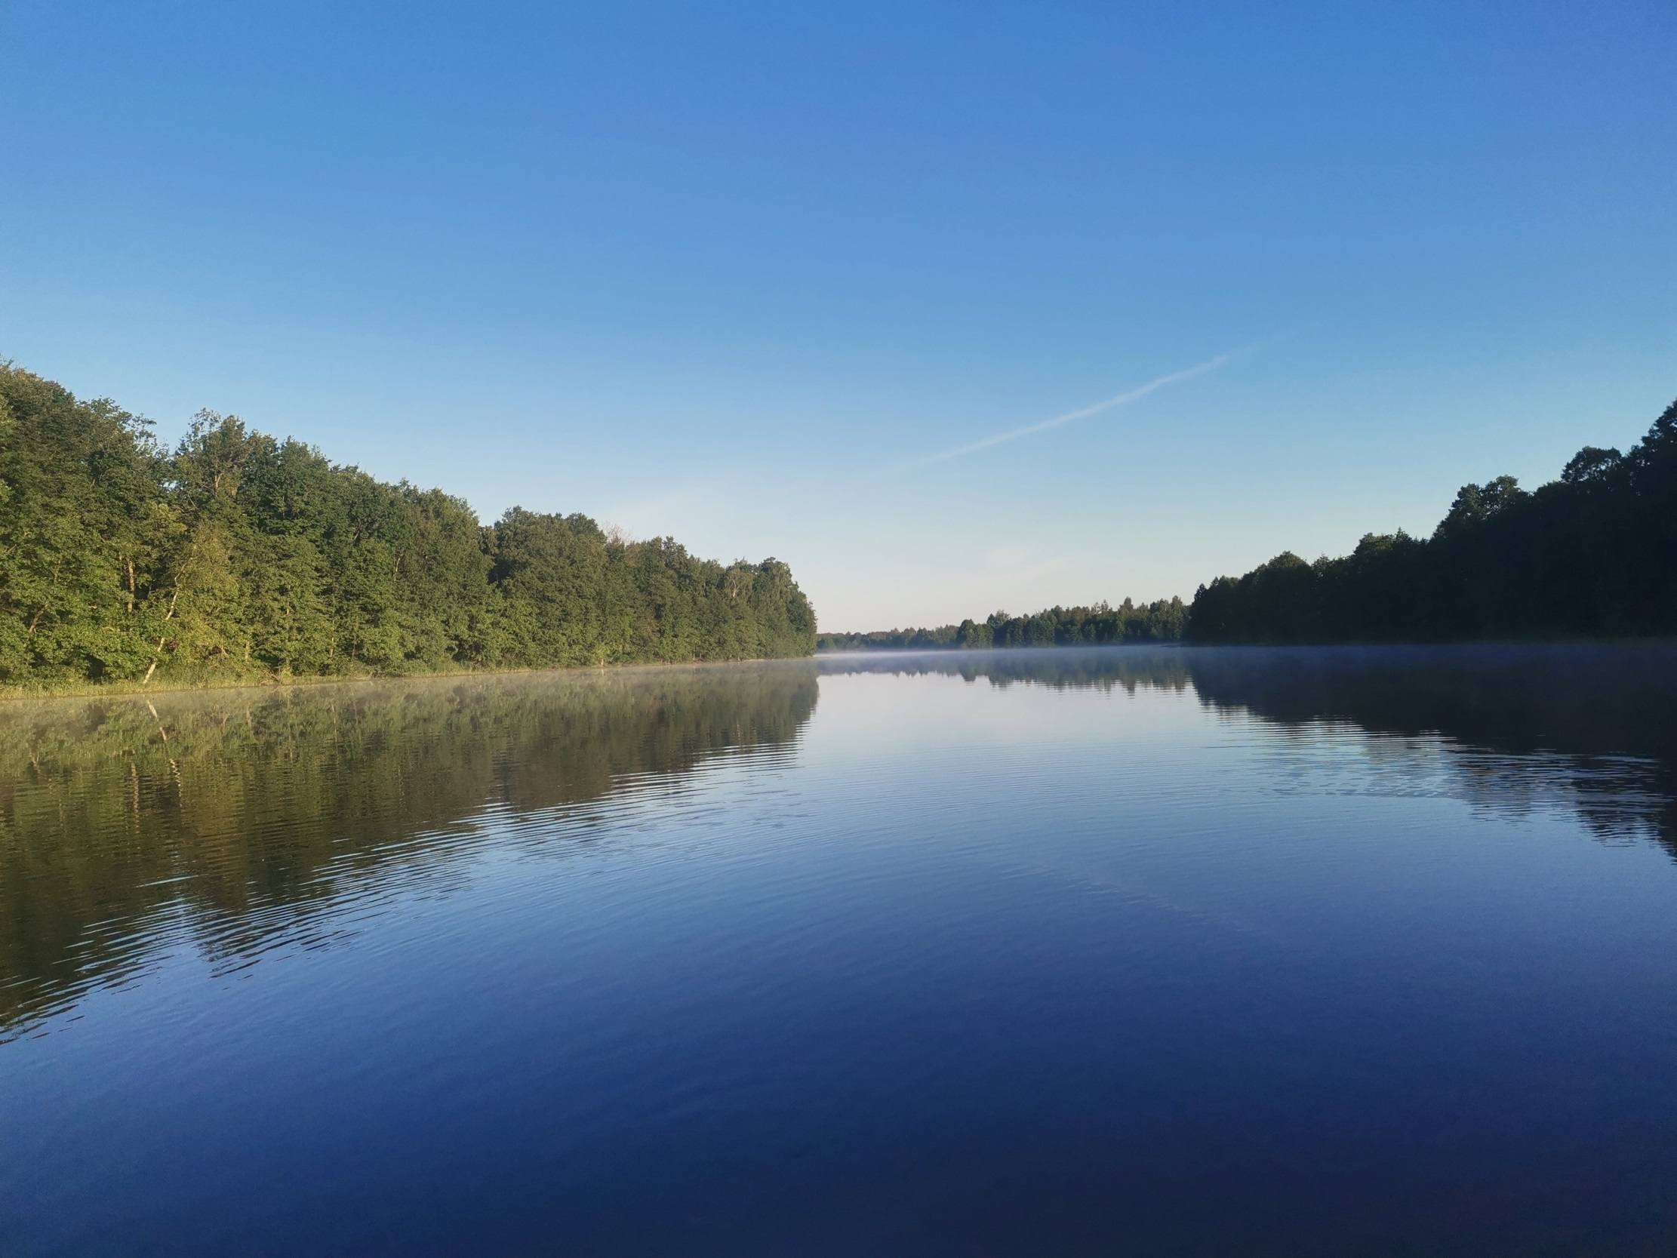
The unique combination of positive factors is making the Eco-park one of undoubtedly best places for recreation in the area of about 400 km around Moscow:
- The EXCLUSIVE location with the unique natural potential and the absence of such analogues basing on the combination of all positive factors;
- OPTIMAL distance from human settlements and roads, and that is why optimal ratio of a wild nature and safety;
- An OASIS of beautiful lakes and rivers in a convenient accessibility from biggest cities, Moscow and N. Novgorod;
- West side of the Nizhny Novgorod region is the MOST promising district in terms of economical development in the Central Russia;
So, the main exclusivity of the Land is a unique combination of seclusion in the beautiful lands with convenient transport accessibility (when you don’t need to go somewhere far in the forests, with not enough safety and infrastructure facilities) and wide opportunities for travel and work : Gorohovets, Gorbatov, Frolishi, Dzerzhinsk, Nizhny Novgorod, Gorodets, Semenov, Murom, Vladimir, Suzdal, Ivanovo, Arzamas, Diveevo, … the Gorkovskoe sea, kayaking and rafting through the Lukh, Klyazma, Kerzhenets, Vetluga, Oka, Volga, Sura.
* Besides, some resorts based not far from here, like the “Chaika” resort hotel and “Rancho 636”, “Ildorf” and “Serebro”, located just 7 km away from the Land, - are the renowned constant leaders among Central Russia resort hotels. And their maximum occupancy is based on the clients coming from Moscow, who loves these hotels for their location first of all … And, to remind, the Eco-park location is more exclusive and definitely better!

Slide 15
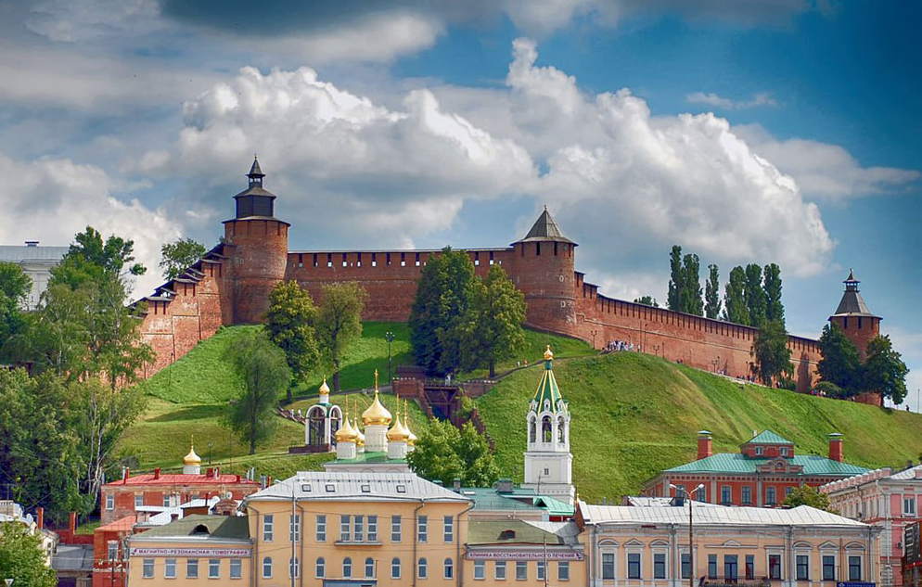
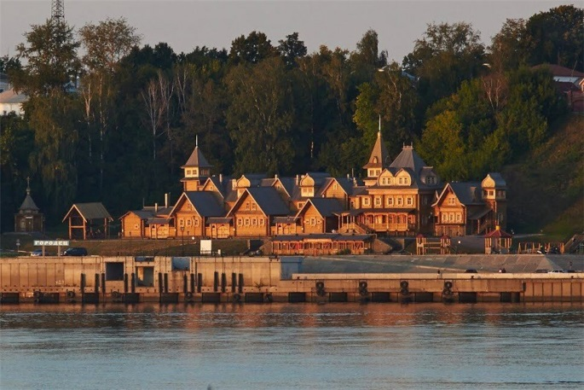
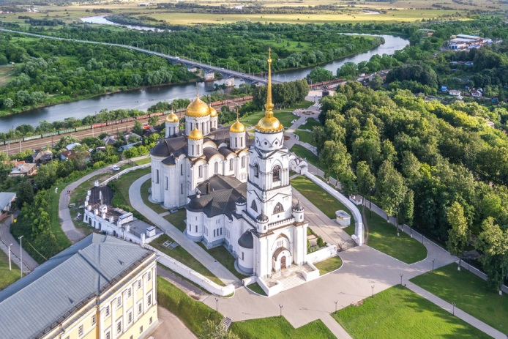
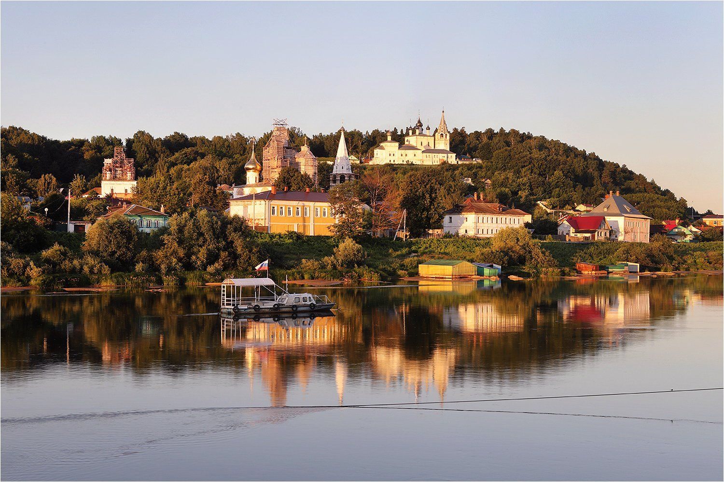
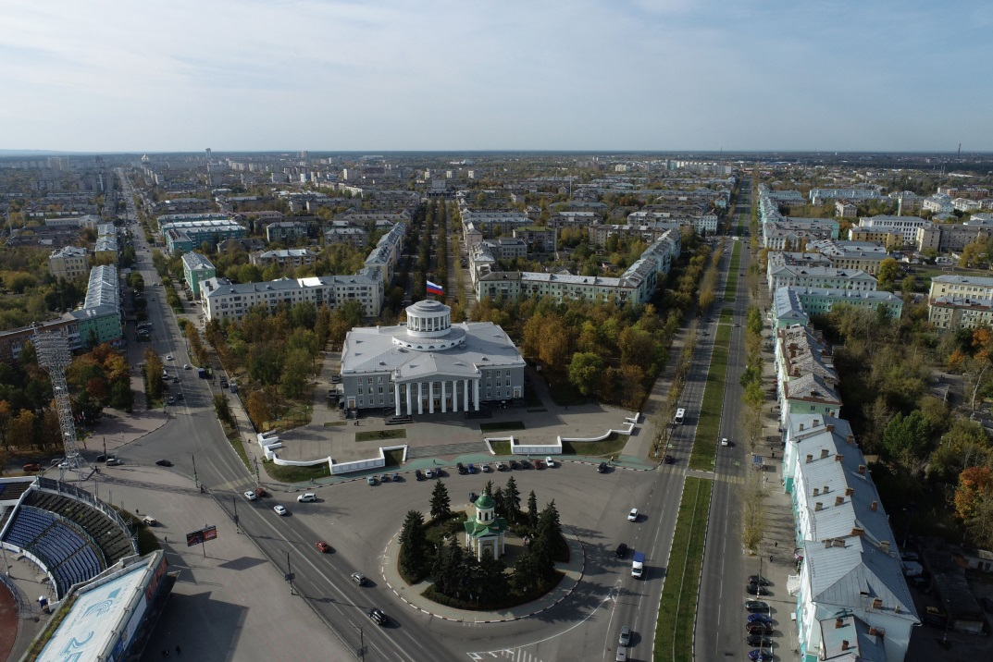
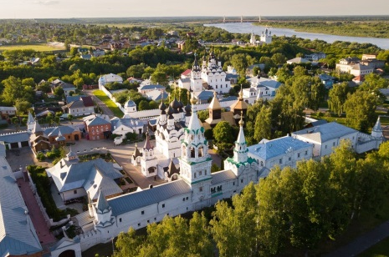
Nizhny Novgorod, 1 hour
Gorodets, 1,2 hour
Vladimir, 2 hours
Gorokhovets, 20 minutes
Dzerzhinsk, 40 minutes
Murom, 1.5 hours

Slide 16
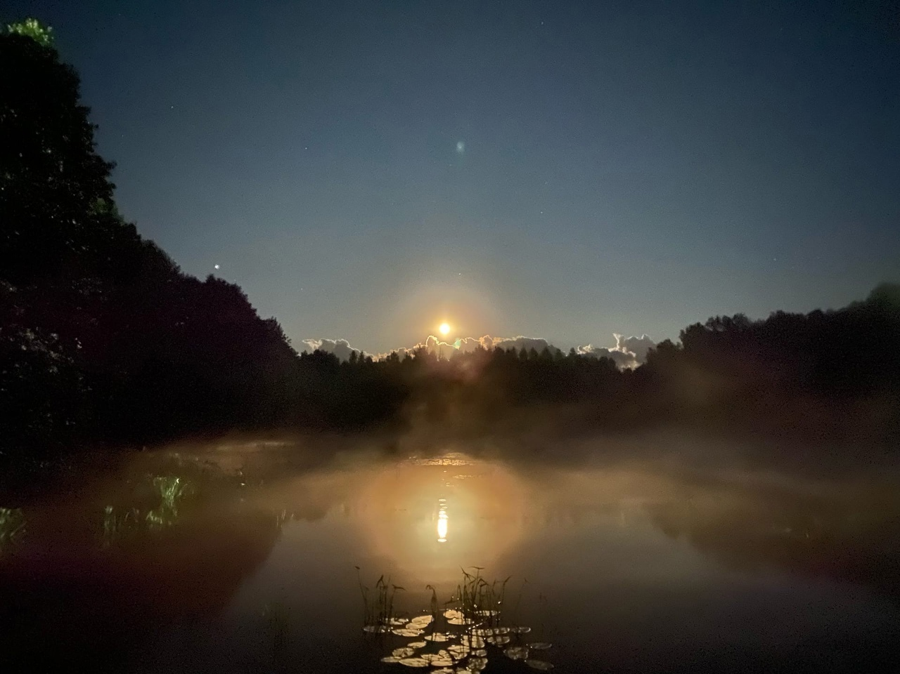
The main IDEA of developing of the Land is creating of Safari Eco-park in and around.
To save and increase natural advantages of these lands, to create ultimate nature resort.
What the Eco-park consists of:
● New 4* resort on the Land (4.4 hectares) + 0.7 hectares (between the Land & the “Chaika” base),
● The “Chaika” camp (budget summer accommodation, open air and sports activities for youngsters),
● Thematic eco and folk paths and safari routes (forests, fields, lakes, rivers),
● Involvement of the surrounding lakes for eco-routes, sports and travel activities.
Basic project of the new 4* complex:
- First class resort (3*+/4*), implemented in surrounding natural landscapes,
- 40 1-2-storey eco cottages with panoramic windows and verandahs, 48 to 120 sq. meters,
- 2-storey main building with 30 rooms and suites, restaurant, business centre, transforming conference hall and class rooms,
- Restaurant and entertaining complex,
- Sports complex with swimming pool, playing ground, track, saunas, SPA,
- Russian banya wooden houses with direct access to the lake,
- Ethno village, household building with laundry, warehouse, boiler house, security and garage,
- Extensive equipment for eco-tourism, sports and entertainments.
Estimated project cost – 370 mln. rubles (payback ~5-6 years from the start of the construction).
*Very important to know that most of the resorts in Russia including some popular in this area are in fact renovated old USSR camps. We have an excellent advantage to use all the best what modern architecture and technologies can give us today, we can create and make truly outstanding things!
We have different excellent OPTIONS for our partners, investors and Foundation sponsors to be involved in this excellent project.

Slide 17
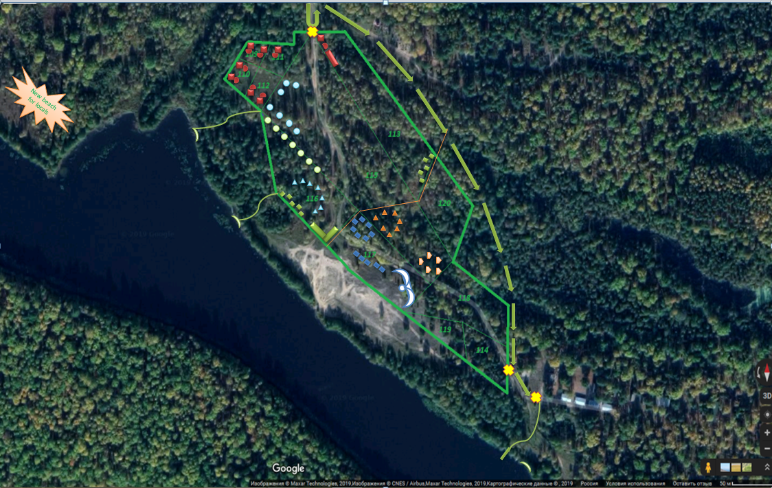
The main idea of the resort is constructing of the cottages within trees, with streams and ponds between them according to the actual ground relief. So, actual location of the buildings depends on the real landscape of trees and ground and chosen types of cottages. We consider location of the Hotel building (seagull form on top of the hill), main restaurant-entertainment building and security cottage at the entrance on above plan as best possible. Locations of other cottages-banyas-playgrounds can vary. Size of the buildings can vary also depending on a final budget.

Slide 18
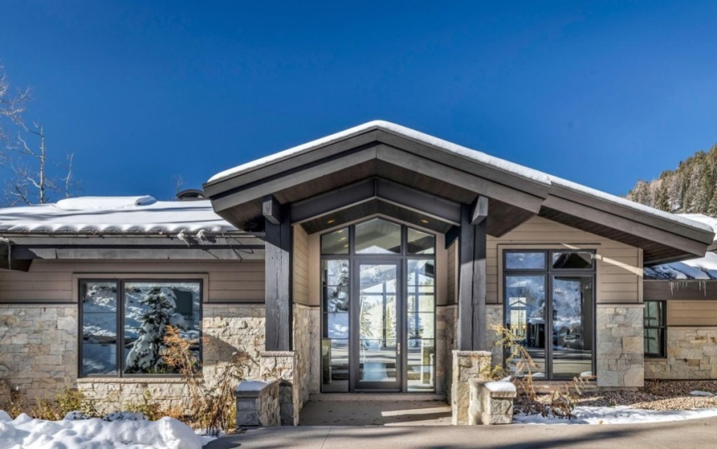
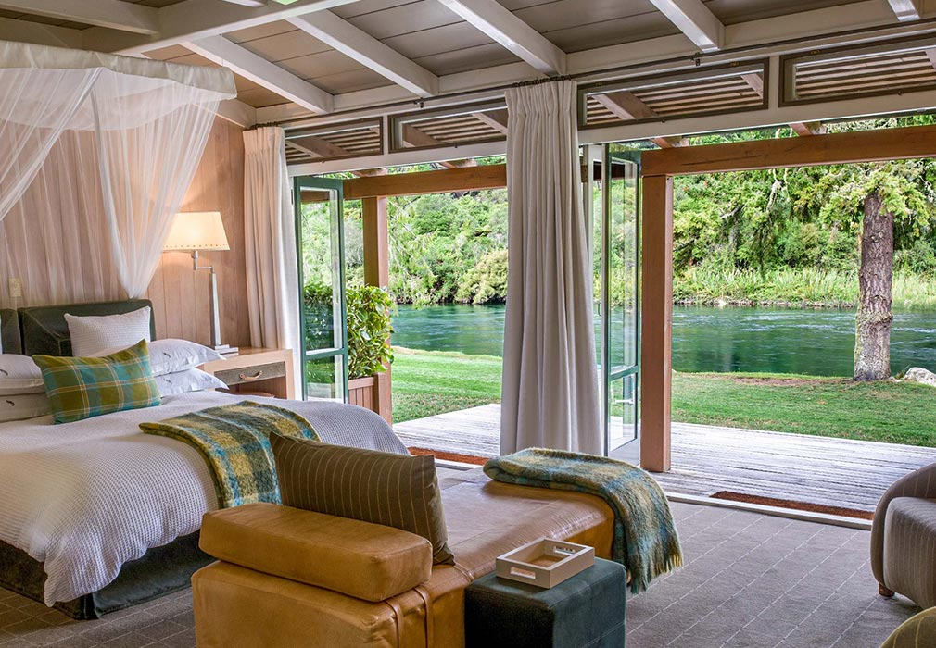
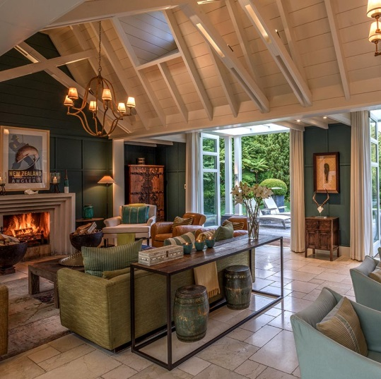
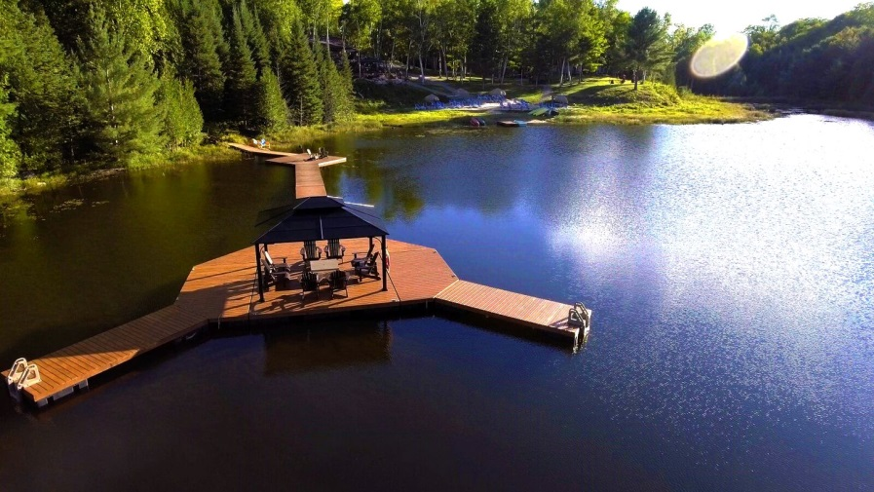
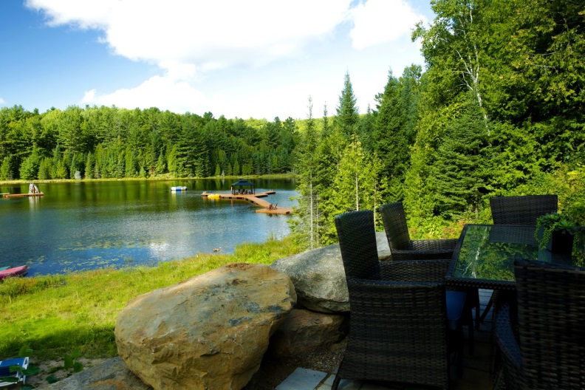
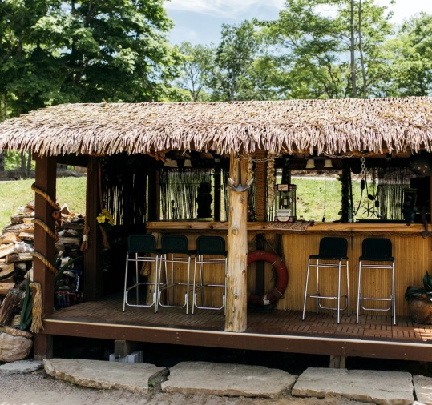
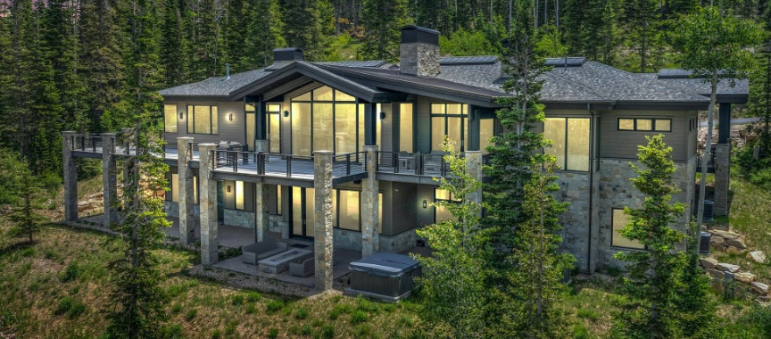
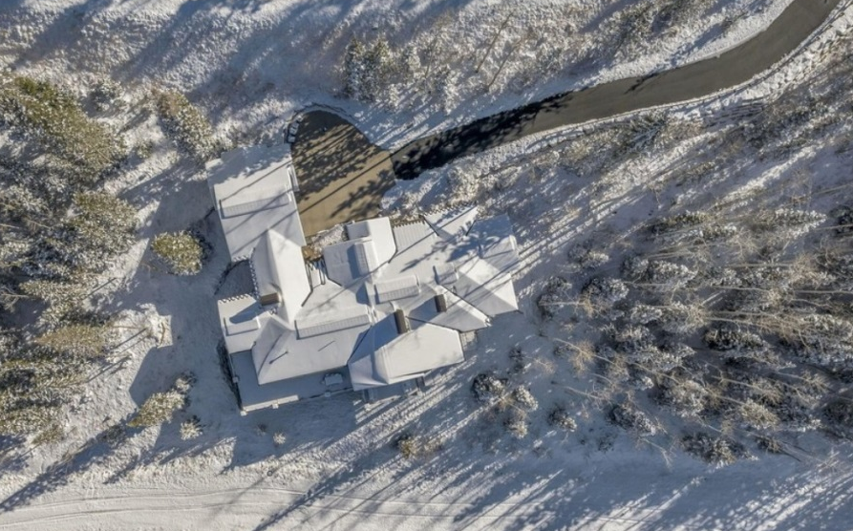
Superior cottage, 64 sq m
Superior cottage, 64 sq m
1 of 2 bedrooms (DBL/TWN+2)
Superior cottage,
Ballroom,22 sq m
Pier and new beach
Chill out beach bar zone
Summer beach bar
Main restaurant and entertainment building
Main restaurant bird view

Slide 19
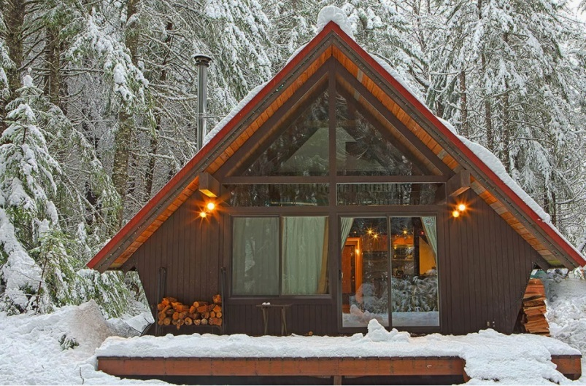
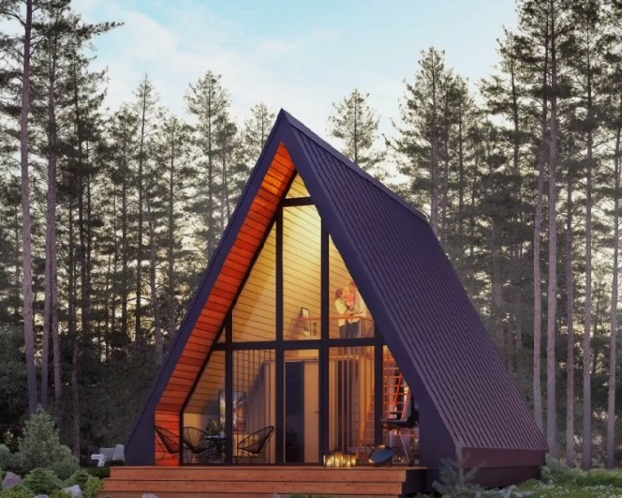
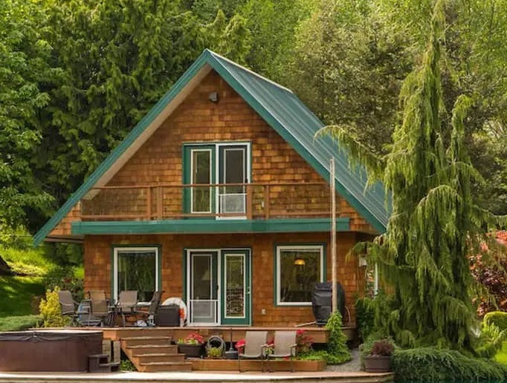
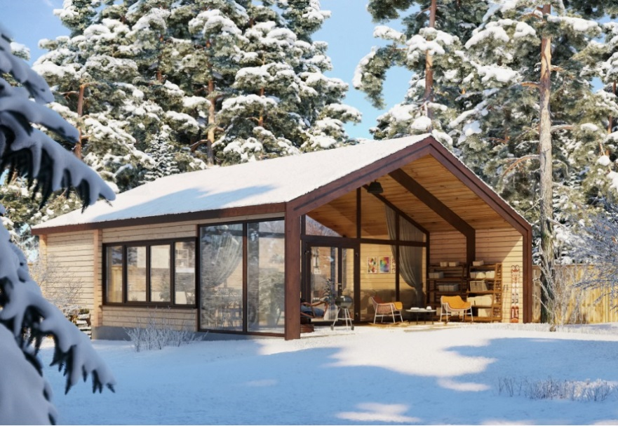
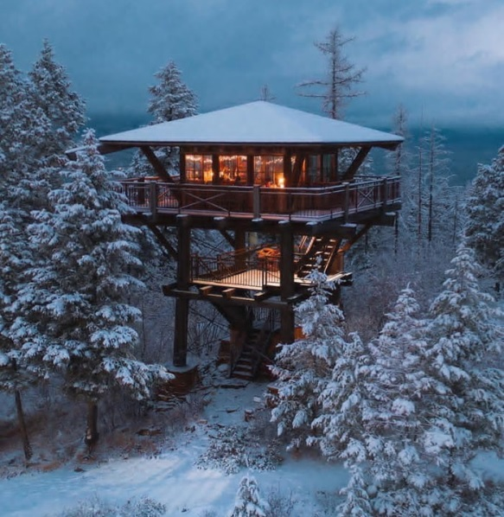
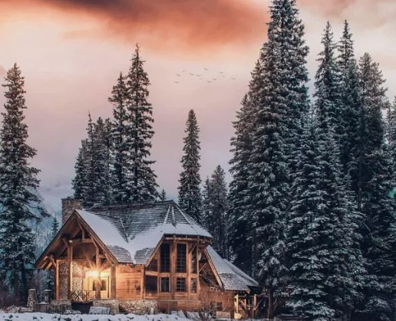
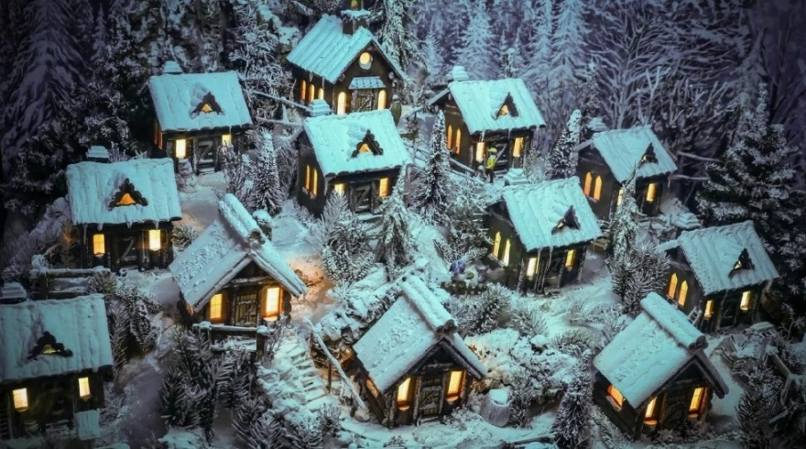
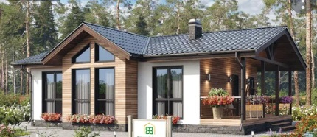

Standard cottage, 42/54 sq m
Standard A-frame, 58 sq m
Family house, 84 sq m
Skyscraper, 36 sq m
Villa, 72 sq m
Modern cottage, 36-48 sq m
Standard cottage, 420 sq.m
Few areas in the resort with
different style houses in each.
Here are preferred examples
to imagine or to choose.
Example of a living area (‘Zaimka’)
Mini-houses, 24 sq m
Budget glamp, tents 24 sq m
(Bio WC & fireplace inside on option)

Slide 20







Hi-tech A-frame cottage, 74 sq m
FaZenda Villa, 96/190 sq m
(Café & ground floor kitchen)
Cheap type, 36 sq m
For Chaika camp
Hi-tech Open cottage, 76 sq m
Tower Villa, 90 sq m
2storey House, 98 sq m
Russian Banya, 30 sq m
(all with Barbeque zone)

Slide 21

PRICES and different OPTIONS for our partners, investors and Foundation sponsors:
1. Basic invest project (380 mln rubles/ ~$ 4 mln), partial or full project control possible,
2. Purchase of the whole Land 4.4 hectare (48 mln rubles/ ~$ 550k),
3. Purchase of parts of the Land to participate in the eco project with your business:
2,12 hectares (№52:22:0700028:115 part) + (№ 52:22:0700028:116) +
(№52:22:0700028:113)
2,47 hectares (№52:22:0700028:115 part) + (№ 52:22:0700028:116) +
(№52:22:0700028:113) + …:109-112
1,98 hectares (№52:22:0700028:115 part) + (№ 52:22:0700028:117) +
(№52:22:0700028:120)
4,4 hectares (№52:22:0700028:115 part) + (№ …:113, 115, 116, 117, 120, 109-112)
4. Sponsorships of the final fitting of the camping ”Chaika”, new pier-cafe and eco paths
5. Sponsorships (many choices) of the family amateur sports games “Forest Games” – charity foundation project to support ecology in the lakes and forests in this very area.
Payment methods:
● Money transfer to the account of the owner, private person or a legal company,
● Direct contract with the Land owner,
● (!) Partial payment is possible as a charity donation or sponsorships contract, including payment by donation of some goods and services,
● 20% of the Land sales is going for the Eco-park development, charity programs needs, the camping development and environmental programs around it. *Please, note restrictions apply for ‘not friendly countries’ according to the Russian Federation Government low issued in March, 2022

Slide 22

NOTHING to compare…
This offer is of a limited time validity. Don’t miss!
The term ‘IT’S ONCE IN A LIFETIME’ CHANCE’ is activated.
We’ll be happy to answer any of your questions.
With best regards,
GEO
E-mail: geo@volga-oka.ru, rusdevelopers@yandex.ru
Т: +7 (495) 960-2826, (916) 500-0650
Хорошо там, где мы есть… | It’s good where we are…

